Slide 1
Activation records
Programming Language Design and Implementation (4th Edition)
by T. Pratt and M. Zelkowitz
Prentice Hall, 2001
Section 9.1-9.2

Slide 2
Subprogram
Simple Call-Return Subprograms
  - Simple copy as Macros
  - FORTRAN Types
  - Current-instruction pointer (CIP)
  - Current-environment pointers(CEP)
  ⬅ 간단하게 설명
Recursive Call

Slide 3
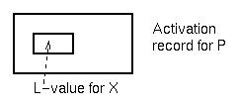
Subprogram control
Remember that data storage for subprograms is in an activation record.
var X: integer;
X is of type integer.
L-value of X is some
specific offset in an
activation record.
Goal is to look at locating activation record for P.
Given an expression: X = Y + Z
1. Locate activation record containing Y.
2. Get L-value of Y from fixed location in activation record.
3. Repeat process for Z and then X.

Slide 4
Scope rules
Scope rules: The scope of a variable is the set of statements where the variable may be accessed (i.e., named) in a program.
Static scope: Scope is dependent on the syntax of the program.
Dynamic scope: Scope is determined by the execution of the program.
Static nested scope: A variable is accessible in the procedure it is declared in, and all procedures internal to that procedure, except a new declaration of that variable name in an internal procedure will eliminate the new variable's scope from the scope of the outer variable.
A variable declared in a procedure is local in that procedure; otherwise it is global.

Slide 5
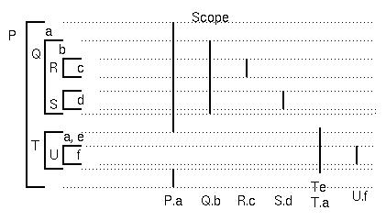
Review of scope rules
Q and T are declarations of procedures within P, so the scope of names Q and T is same as scope of declaration a.
R and S are declarations of procedures in Q.
U is a declaration of a procedure in T.
Storage managed by adding activation records, when procedure invoked, on a stack.

Slide 6
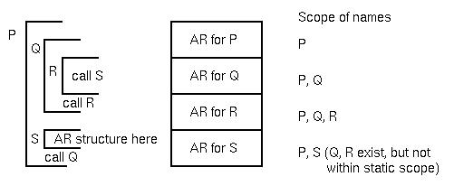
Activation record stack
Problem is: How to manage this execution stack?
Two pointers perform this function:
1. Dynamic link pointer points to activation record that called (invoked) the new activation record. It is used for returning from the procedure to the calling procedure.
2. Static link pointer points to the activation record that is global to the current activation record (i.e., points to the activation record of the procedure containing the declaration of this procedure).

Slide 7
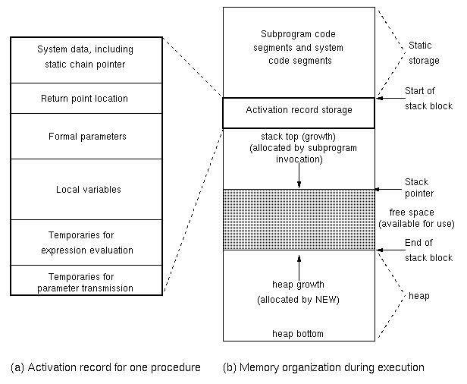
Activation record structure

Slide 8
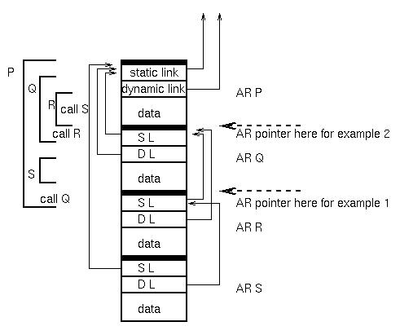
Example of activation record stack
For following examples, assume following static program and stack:

Slide 9
Activation record example 1
Example 1. In R: C := B+A; ⇒ C local, A and B global
For each variable, get pointer to proper activation record.
Assume AR is current activation record pointer (R).
1. B is one level back:
  - Follow AR.SL to get AR containing B.
  - Get R-value of B from fixed offset L-value
2. A is two levels back:
  - Follow (AR.SL).SL to get activation record containing A.
  - Add R-value of A from fixed offset L-value
3. C is local. AR points to correct activation record.
  - Store sum of B+A into L-value of C

Slide 10
Activation record example 2
Example 2. Execution in procedure Q: A := B
⇒ B is local, A global
Assume AR is current activation record pointer (Q)
1. B is now local. AR points to activation record
  - Get R-value from local activation record
2. A is now one level back
AR.SL is activation record of P
  - Store R-value of B into L-value of A
Compiler knows static structure, so it can generate the number of static link chains it has to access in order to access the correct activation record containing the data object. This is a compile time, not a runtime calculation.

Slide 11
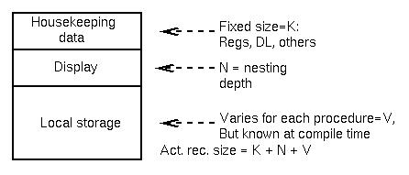
Use of displays
Problem with static links:
Many links to follow if deeply nested. (But how common is that?)
Use of displays reduces access always to 2 instructions:
1. Access Display[I] = Act. Rec. pointer at level I
2. Get L-value of variable (fixed offset in act. rec.)
Activation record structure:

Slide 12
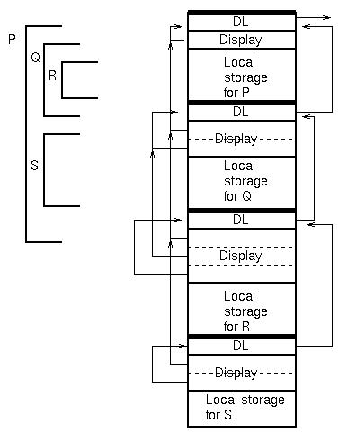
Display for previous example

Slide 13
Accessing variables
Data access is always a 2-step process:
1. [If non-local] Load Reg1, Display[I]
2. [For all] Load Reg2, L-value offset (Reg1)
Size of activation record for a procedure:
Housekeeping storage (Fixed size = K):
  - Dynamic Link
  - Return address (in source program)
  - End of activation record
  - Registers
Display
Local data storage

Slide 14
Creating activation records
To create new activation record (e.g., P calls Q):
Assume have pointer to P's activation record.
1. Get EndStack pointer from P's activation record.
This is start of Q's activation record.
2. Add K+NewDisplaySize+LocalStorageSize.
3. Save as new EndStack in Q's activation record.
4. Set DL in Q to point to old activation record (P).
5. Fill in housekeeping in Q's activation record.
6. Set up new display in Q's activation record.
To create a new display to call from level I to level J:
Copy Display[1..J-1] from calling activation record.
Add new activation record pointer as Display[J].
To return:
Use dynamic link in current activation record to get old activation record.
Use return address in housekeeping area to jump to.

Slide 15
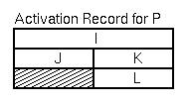
Blocks in C
Blocks in C are handled as union record types:
P()
{ int I;
{int J;
. . . }
{ int K; int L;
. . . }
. . . }
J and K cannot exist at the same time, so use the same space for them.

Slide 16
Optimizations in activation record design
1. Instead of displays, use M registers only:
E.g., M1, M2, M3, M4 only.
What if a procedure is nested 5 deep?
1. Illegal program?
2. Spill to displays only in this case?
2. Note that C was designed for efficient execution:
No nested procedures
No need for displays or static links
But needs dynamic links.

Slide 17
C++ storage access
General properties
1. Procedure allocations follow general rules of C
Allocate activation records on a stack
No need for static links, but need dynamic links
2. Class variables are allocated like structs in C.
[Structs in C++ can have function members. Functions in structs are by default public, while in a class are by default private.]
3. Static functions are not represented in runtime activation records
4. Objects requiring dynamic binding (i.e., virtual functions) are present in runtime activation records

Slide 18
Sample C++ allocation example
class A {
public: int x;
virtual void p() {...};
void q() {...p()...};
protected: int y;
private: int Z;
...}
class B:A {
public: int w;
virtual void p() {...};
void r() {...p()...};
private: int v;
virtual void s() {...};
...}

Slide 19
Symbol table for example
Name Type Access Mode Location
X var public static A(1)
P func public dynamic A(2)
Q func public static addr of proc
Y var protected static A(3)
Z var private static A(4)
W var public static B(5)
P func public dynamic A(2)
R func public static Addr of proc
V var private static B(6)
S func private dynamic B(7)

Slide 20
Class instance records at runtime
X: R-value
X: R-value
P: Addr of P in B
P: Addr of P in A
Y: R-value
Y: R-value
Z: R-value
Z: R-value
W: R-value
V: R-value
Class A
S: Addr of S in B
Class B

Slide 21
추가
FORTRAN의 COMMON문
  - 간단히 설명
Function parameter에서 scope rule
  - 환경 접근방법 간단히 설명

